Slide 1
Virtues in Practice:
Temperance

Slide 2
Temperance
Enjoying things in a proper, balanced way
Only having a healthy amount of something good
Requires control over self
Will following intellect
Refers to good things→ ex.s
Lack of temperance = slavery

Slide 3
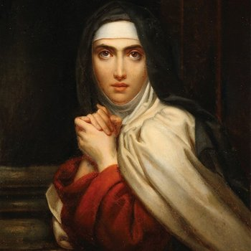
PreK-2nd: St. Teresa of Avila
Spanish Carmelite nun
Youth→ social life, appearance
Nun
Lived comfortably
Social
“Converted” and led others back to fidelity

Slide 4
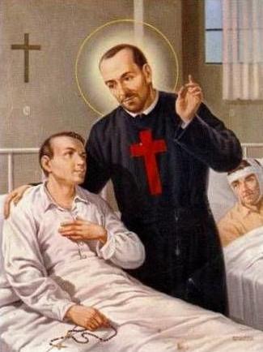
3rd-5th: St. Camillus de Lellis
Italian, priest, founder
Child/youth→ many bad habits/practices
Dropped out of school
Became soldier
Wounded
Job w/Franciscans
Devoted to serving others, penance

Slide 5
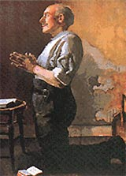
6th-8th: Ven. Matt Talbot
Irish, layman
Did not finish school
Became alcoholic
Chose to change & persevered
Did penance, cared for sick, prayed daily, weekly confession

Slide 6
Live it Out!
Give up your favorite activity, toy, food, etc. for a period of time
Commit to something you should do but don’t do: time with family, sleep, prayer, etc.
Evaluate how much time you spend on different things each day

